Slide 1

Biodiversity in National Parks
Cletus Norton
Oct. 14 2020

Slide 2
1.1 Information about the data
This is a capstone project for the data science path, the provided the data for this project is fictional. The idea was to act as a data analyst for the National Parks Services, with preset questions to be answered.
The data provided contains 5541 unique species ranging from plants to animals. Plants(4,803) were the most commonly counted species, with birds (521) and mammals(214) being the dominent species of animals. From this information I was able to check on conservation status, however this data didn’t provide information about which national park the counts were made in.

Slide 3
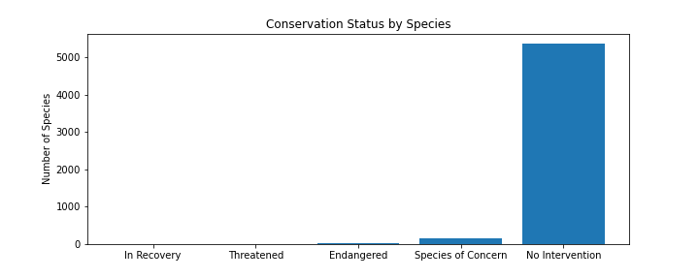
1.2 Conservation Status
5363 Species with no intervention
151 species of concern
10 threatened
15 Endangered
4 in Recovery

Slide 4
The previous chart shows the majority of the species in the park do not need intervention. While it also points out that we have more concerns that we have recoveries.

Slide 5
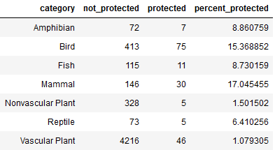
1.3 Protection Status
This provides a breakdown of the species type in protection.
Birds and mammals have the highest percentage of species in protected status
Note, that vascular plants have a higher quantity in protected status, but lower percentage because of the abondance of species counted.

Slide 6
On first glance, the data suggests that birds are more endangered than mammals (Pvalue of 0.68). When checked in a Chi squared test, the significance did not prove out, but it did when we compared reptiles to mammals (Pvalue = 0.03).

Slide 7
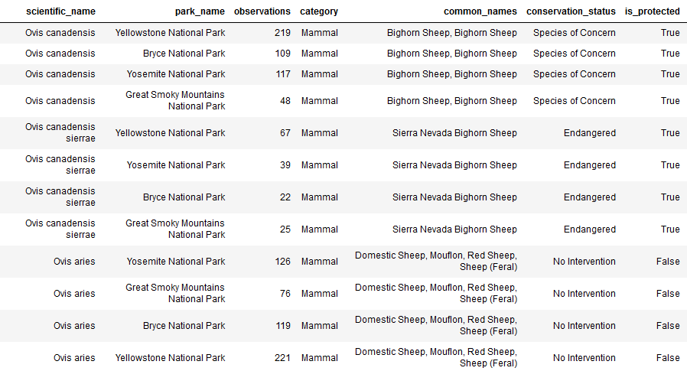
1.4 Sheep Observations in the National Parks
The data below is based on observations made at the parks over a seven day period.
We are able to this data and associate it with the park where the sheep were observed.
We were then able to estimate observation rates, to assist in the research into foot and mouth disease.

Slide 8
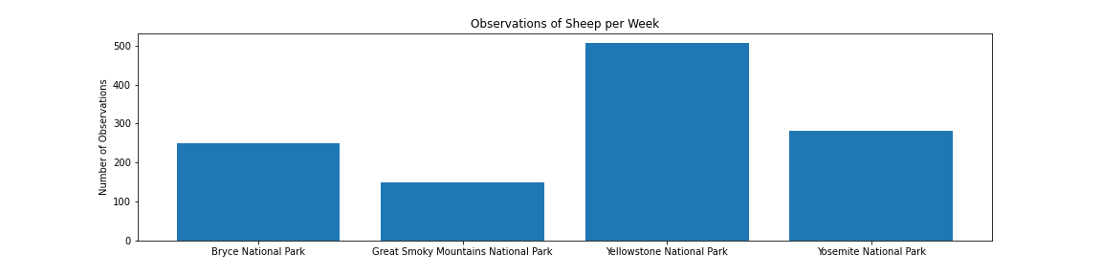
1.5 Sheep Observations in the National Parks Bar plot
The chart below gives us a weekly observation rate in each park for the foot and mouth disease program.
With 15% infection rate at Bryce and Yellowstone running a prevention program. We were able to figure out sample size.
To be able to acheieve the minimum detechtable effect, we would need a sample size of 890.
We will need about 3.5 weeks to reach this sample size at Bryce and 1.5 weeks at Yellowstone.

